Slide 1
TDD by Example
Devlin Liles: Improving
Eric Burcham: Enterprise Products (And Former Improver)

Slide 2

GIANT LOGO!!!

Slide 3
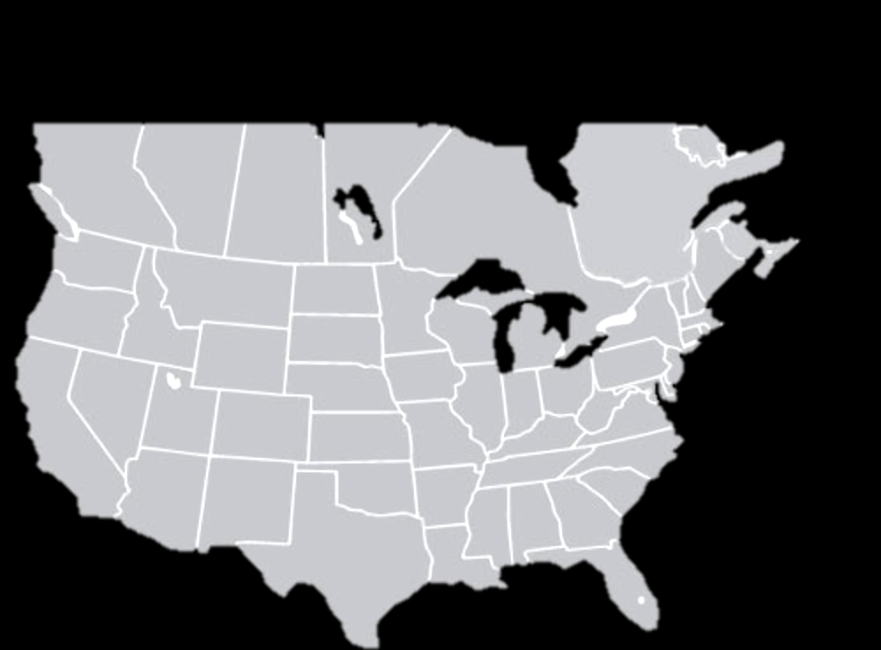

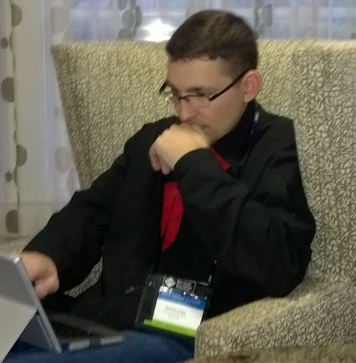

Speaker
Devlin Liles
Husband
Father
Christian
Improver
300+ Improvers
Software Developers
Agilists
Industry Thought Leaders
Teachers/mentors/coaches

Slide 4
Eric Burcham
Athletics
Used to race motorcycles, but ran out of talent doing 80 with his knee down.
Can pilot bicycles down severe inclines with unflagging speed.
Humor
Tells bad (OK, Awful) jokes.
Cribs classic college entrance letters from the internet.
Culinary
Cooks a great steak. Really.
Technology
Coding for a living 24 years.
Full stack developer. (Unless when you said “front-end developer” you meant “designer.”)
2pɹ4ʍʞɔ48 pu4 uʍ0p 3pı5pdn 7331 37ıɹʍ u4ʞ
Makes pretty decent BBQ too.
Ruins pretty much everything else.

Slide 5
Super-Duper List of Some Kinds of Tests
Unit
Dead Simple
Collab
As simple as possible
Requires more than one instance
Requires more than one thread
Integration
They require real outside dependencies
Functional
Check a Feature for Correctness
Compare Results of a Given Input Against a Spec
Not Concerned With Intermediate Results
Not Concerned With Side-Effects
Acceptance
Tests Performed on the Full System
Described in Plain English
Check the Software Meets the Requirements
Just Pass or Fail
These are also object collaboration tests
Hella Fast™
In-Memory
Tiny

Slide 6
Test Driven Development
THINK!
Green
Refactor
Red
TDD

Slide 7
BDD / FDD / Your Process With TDD
?
THINK!
Red
Green
Refactor
THINK!
Green
Refactor
Red
TDD

Slide 8

It’s About to Get Real
$${\left(\sqrt{−x}\right)}^{2}$$
This is an EXPERIMENT to found out how bad a presentation can go.
The collaborative portion has exactly zero preparation.
Otherwise it wouldn’t be TDD by example. It would just be boring.

Slide 9

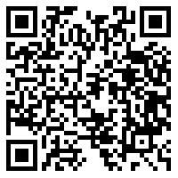

Stop by the Improving Booth
Interested in Improving?
Here are some ways
you can Improve
*Free Lunch-and-Learns
*Meet our recruiter - we’re hiring
Training at Improving
We have several classes coming up with a special TechFest discount
@ImprovingHou
@lifeatimproving

